Slide 1
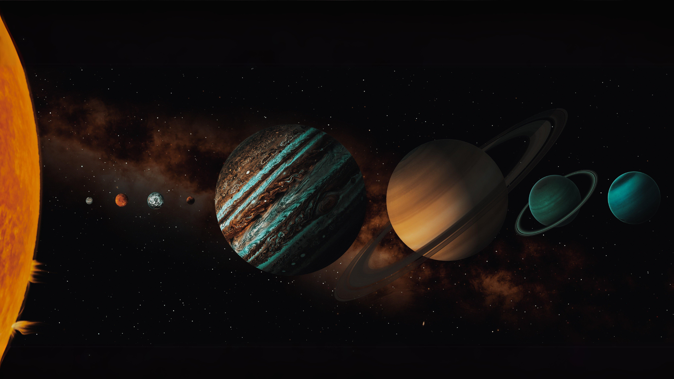
Atoms to Astronomy
Thinking like an experimentalist

Slide 2
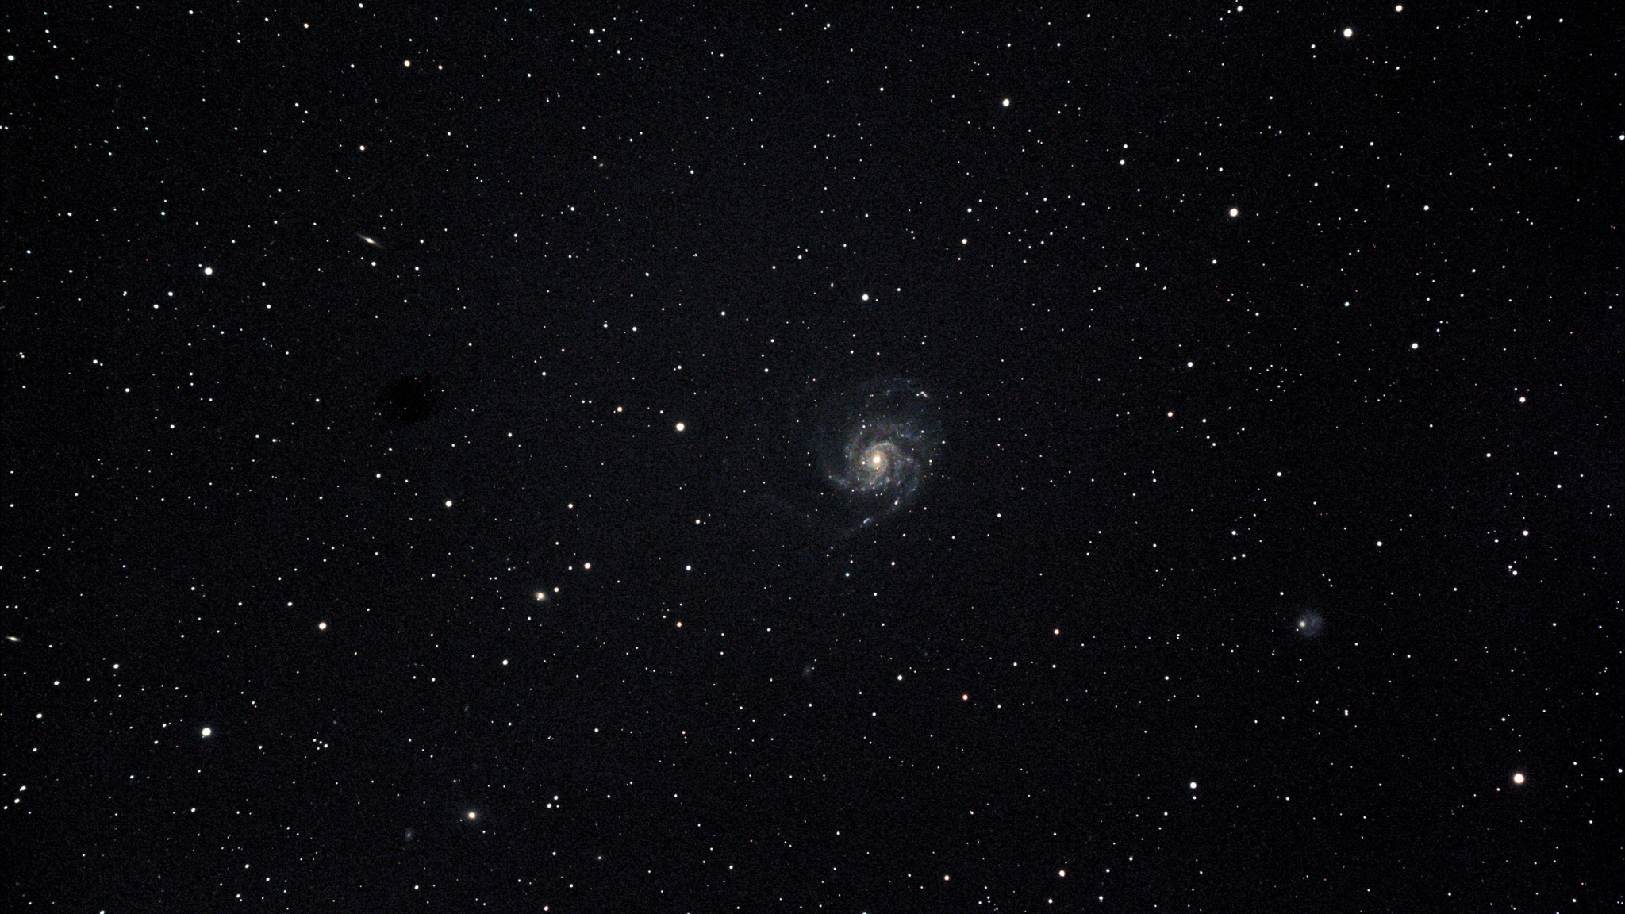
Overview
01
02
03
04
Electricity and Magnetism
Nuclear Science
Gravitation
Afterword

Slide 3
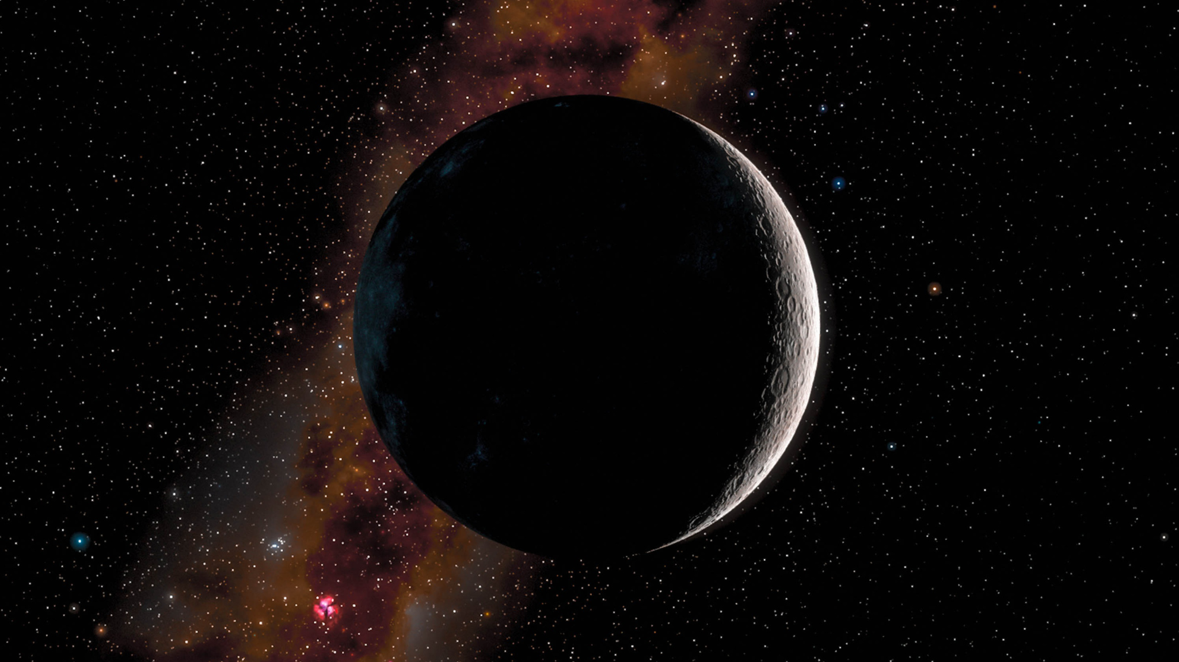
01
Nuclear Science

Slide 4

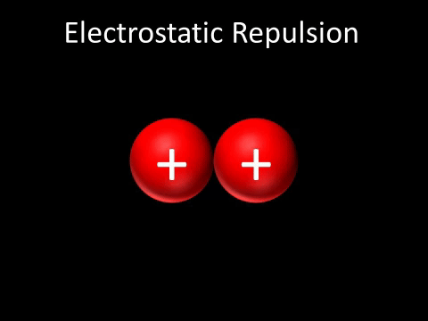
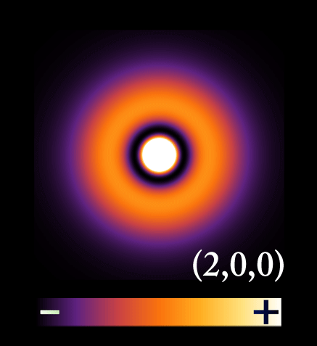
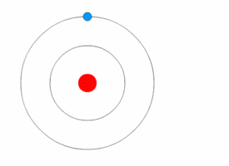
The Atom
Atoms are made up of positive charge protons and negative charge electrons. All protons lie in the middle of an atom while electrons orbit in clouds.
Bohr Model
Schrodinger Model

Slide 5
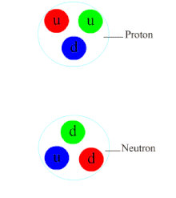
Strong Force
A strong force keeps the positive charge protons together in the nucleus.
“Work” is done by the nucleons (protons and neutrons) through the strong force! Adding more nucleons does more work and thus releases more energy!

Slide 6
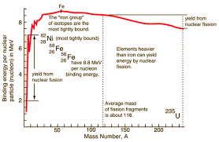
E=mc²
Einstein postulated that energy and mass are fundamentally related. Mass can be converted into energy and vice-versa!
Energy released by by strong-force interactions is called “binding” energy. Different atoms have different average binding energies.

Slide 7
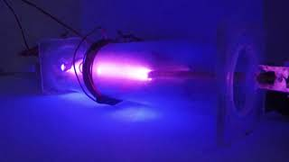
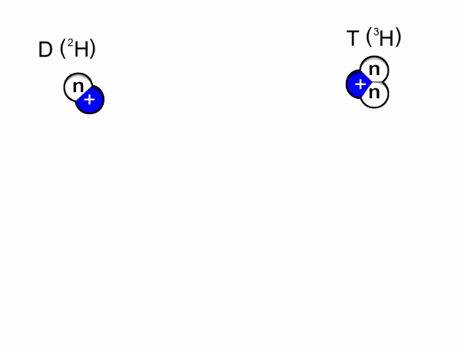
Fusion
Light atoms can fuse together to release energy. However, it is extremely difficult to get small atoms to fuse!

Slide 8
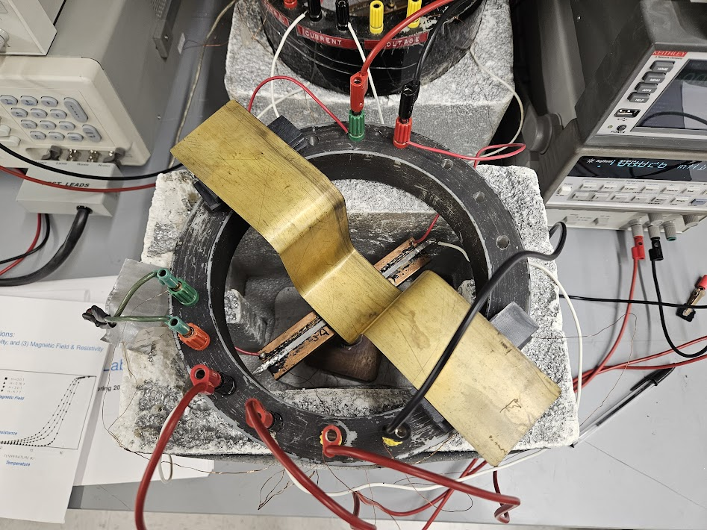
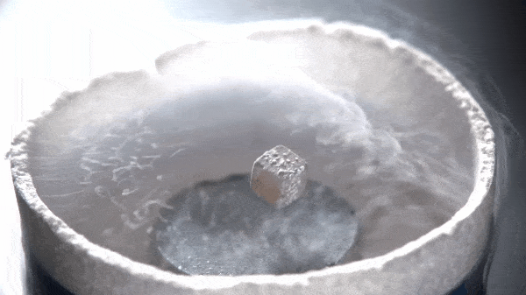
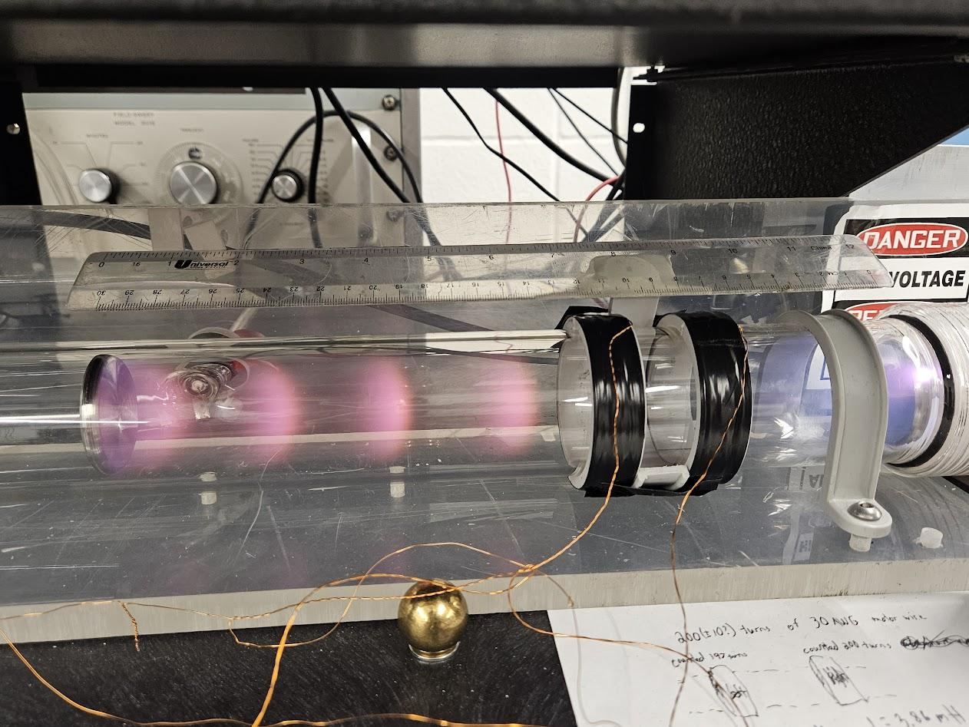
Materials

Slide 9
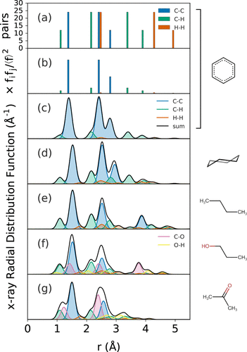
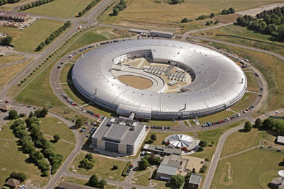
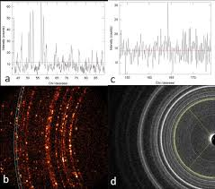
Diffraction
Synchrotron

Slide 10
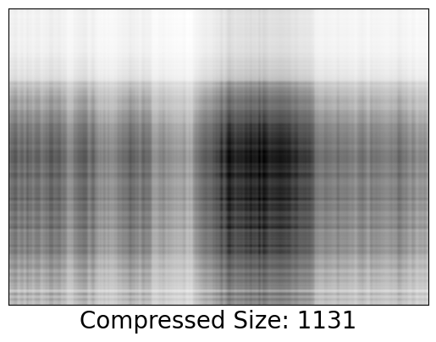
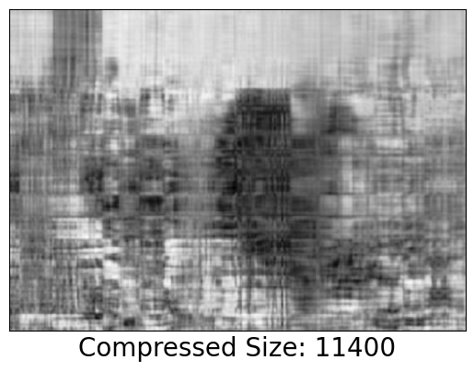
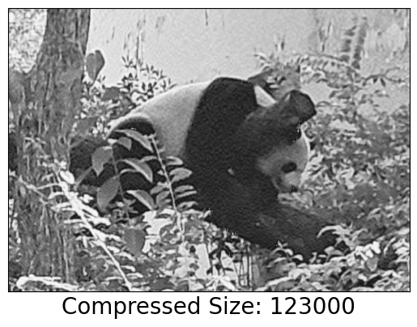
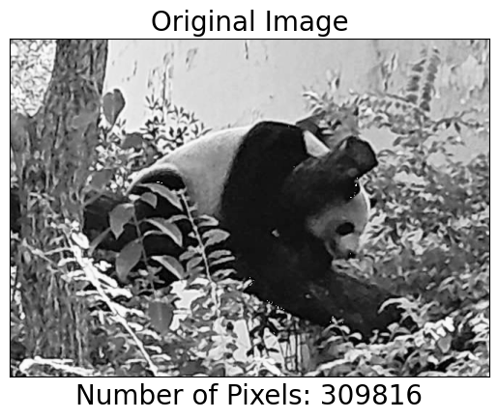

Slide 11
Mapping
Demo

Slide 12
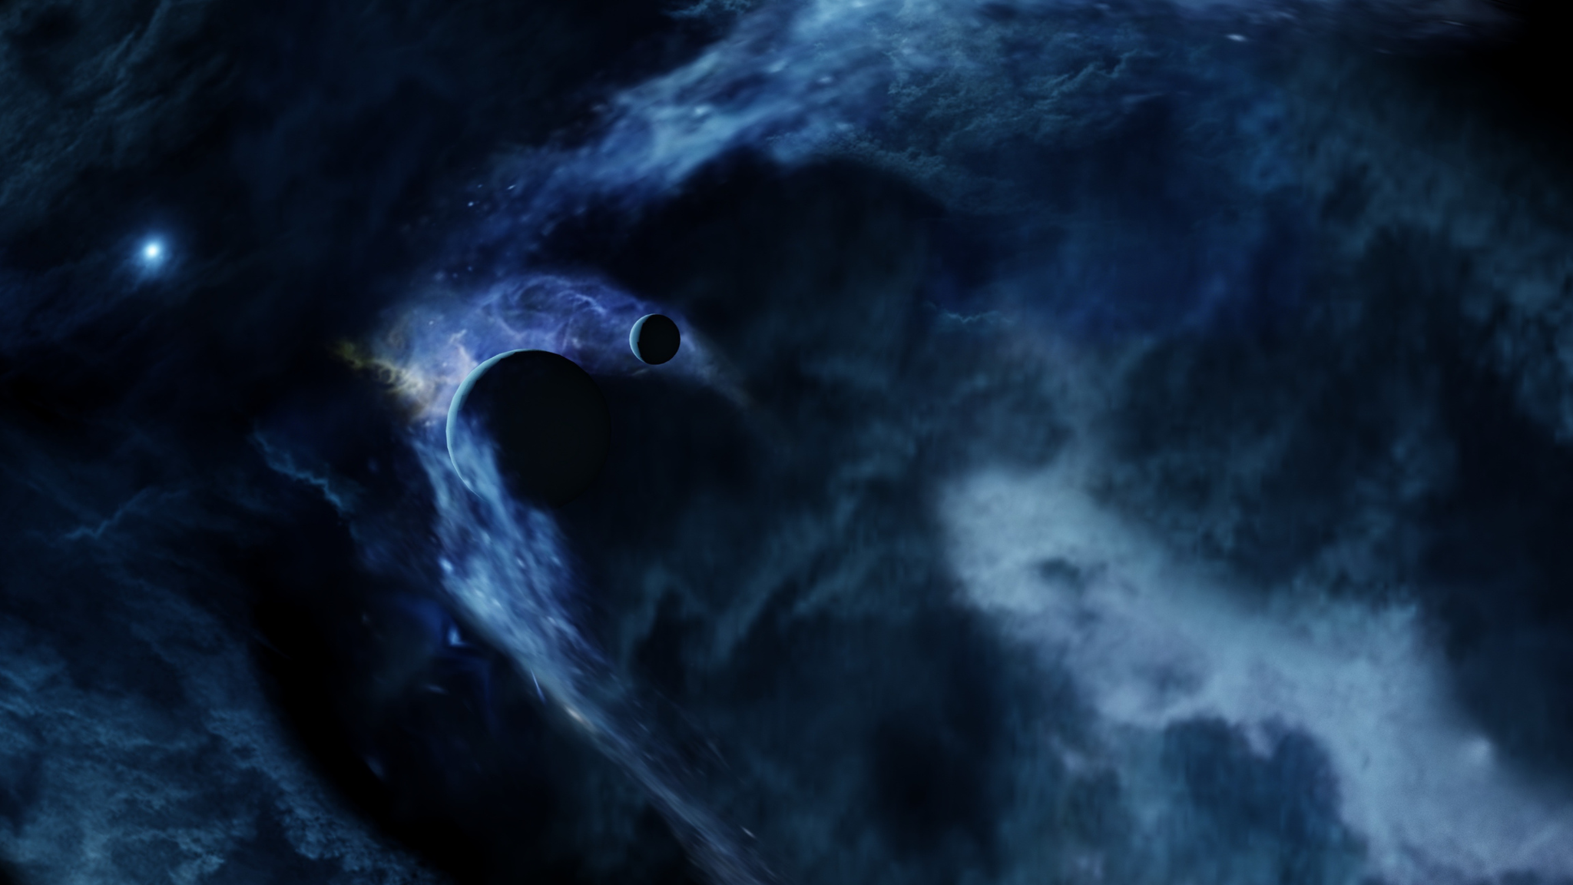
Electricity and Magnetism
02

Slide 13
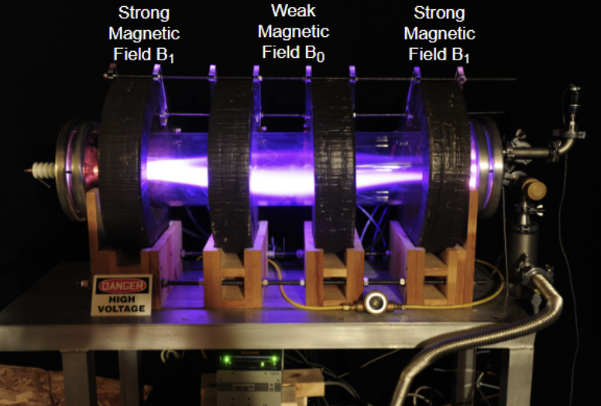
Confinement
Light atoms can fuse together to release energy. However, it is extremely difficult to get small atoms to move the way we want!
We can use magnets to lead these atoms along different paths!

Slide 14

Collision
When we have many particles together, they tend to collide.
Collisions always conserve momentum, but the initial and final velocities can vary!
Charged particle collision can be treated as elastic: no energy will be lost!

Slide 15
Interactions
Demo

Slide 16
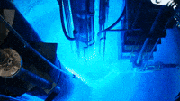
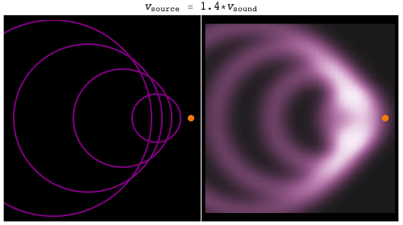
EM Waves
Light is an electromagnetic wave.
These waves travel at the speed of light!
Nothing can travel faster than the speed of light in a vacuum.

Slide 17
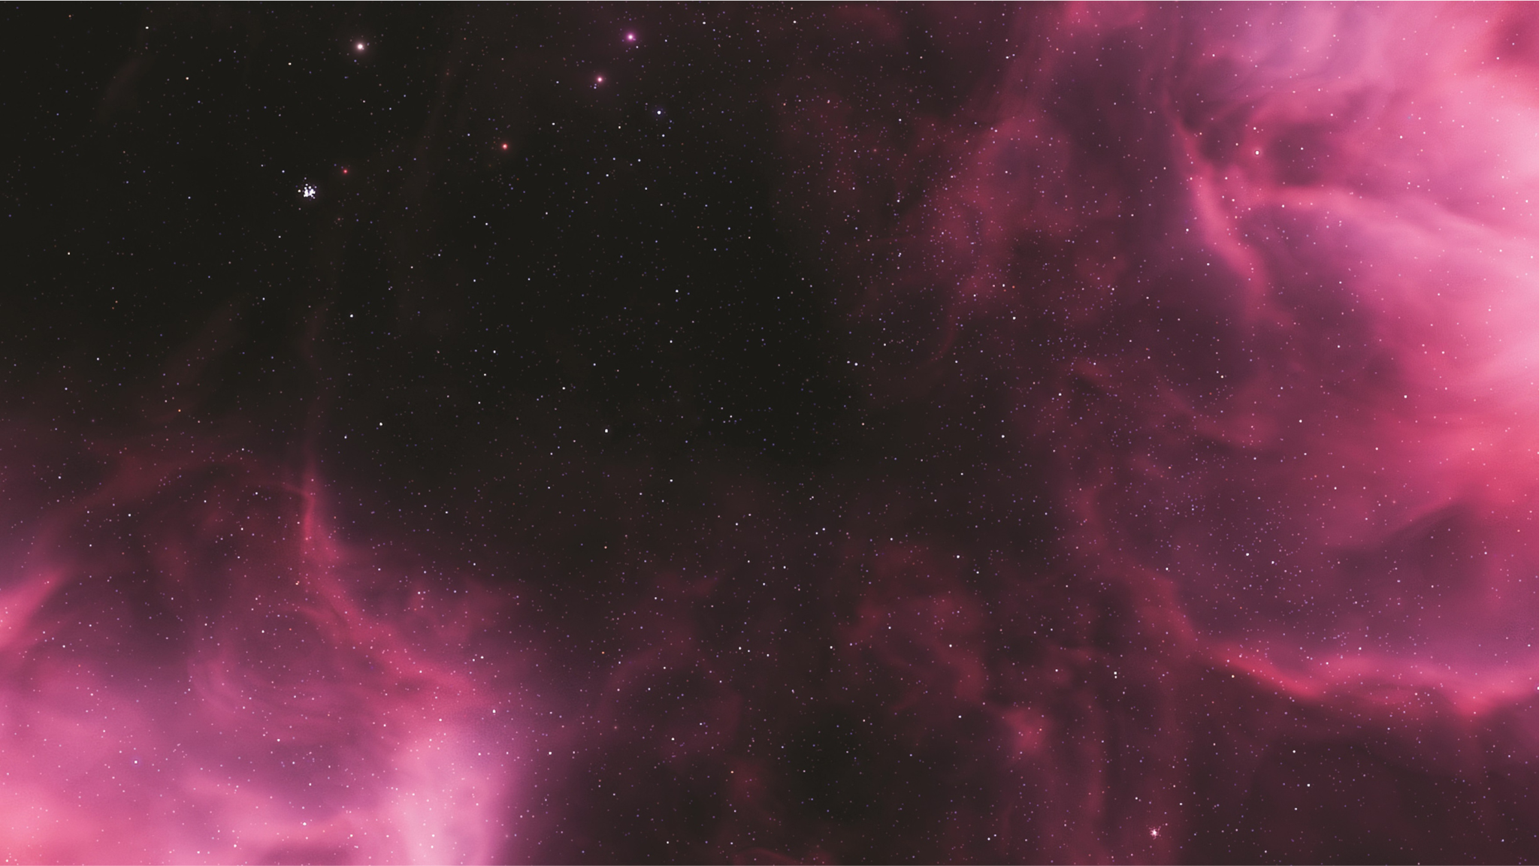
03
Gravity

Slide 18
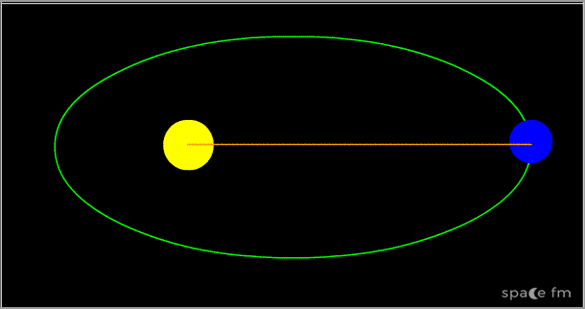
Kepler’s Laws
Kepler’s first law: planetary orbits are elliptical.
Kepler’s second law: orbits sweep out the same area for any given period of time.
Kepler’s third law: the period of an orbit squared is proportional to the cube of the length of the (semi-major) axis of rotation.

Slide 19
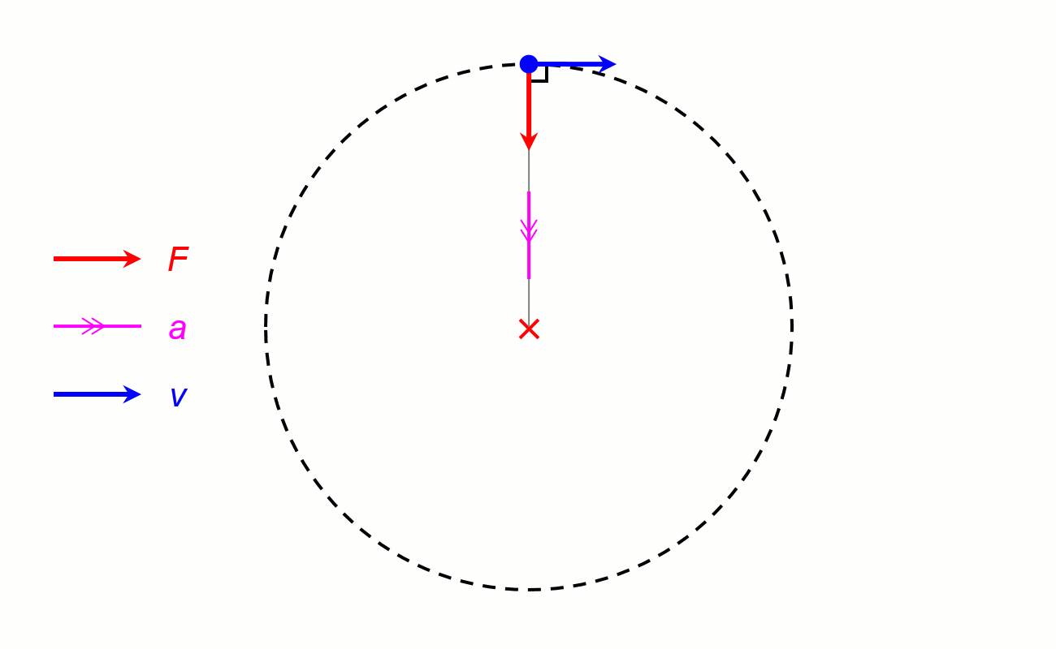

Newton’s Laws
Newton’s second law: the force on a mass equals the product of its mass and acceleration.
Newton’s third law: for every action (force) there is an equal and opposite reaction.
Centripetal force: F=mv²/r

Slide 20
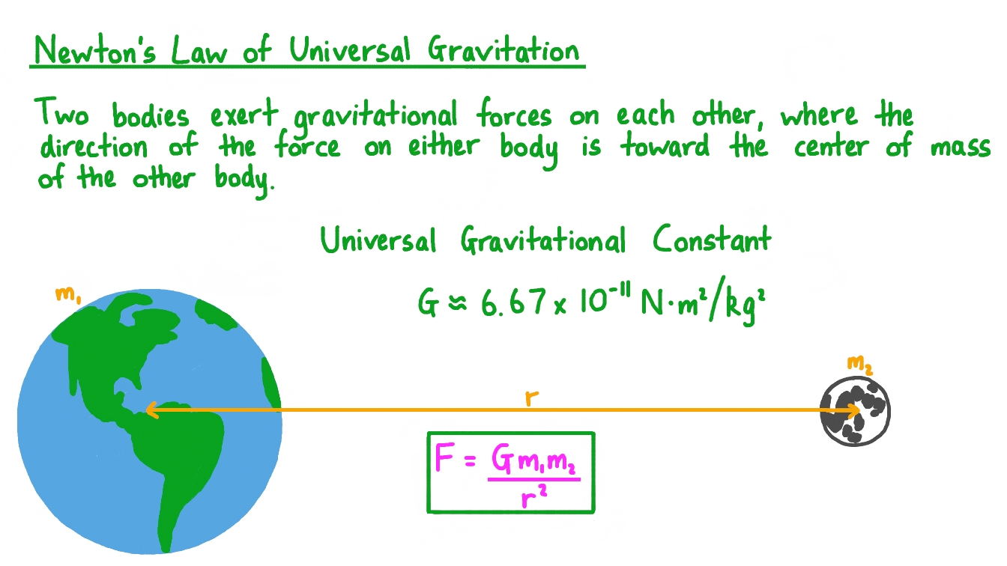
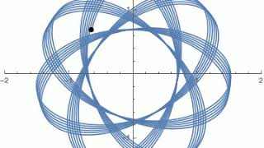
Universal Law

Slide 21
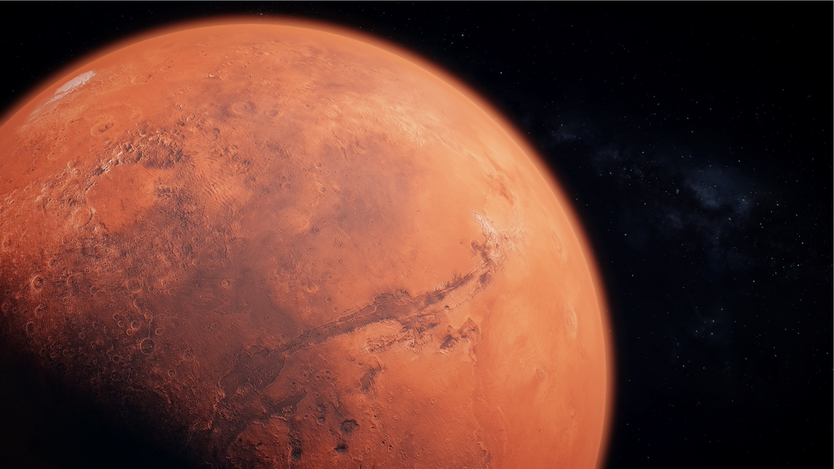
04
Afterword

Slide 22
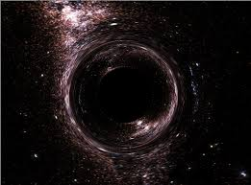
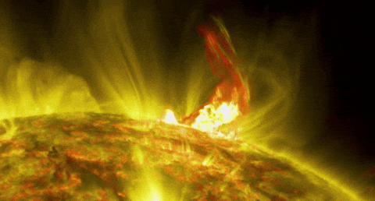
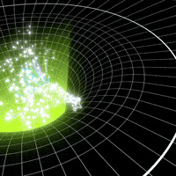
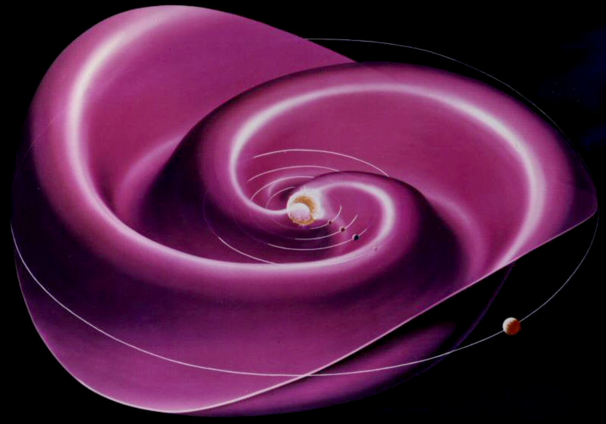
Relativity

Slide 23
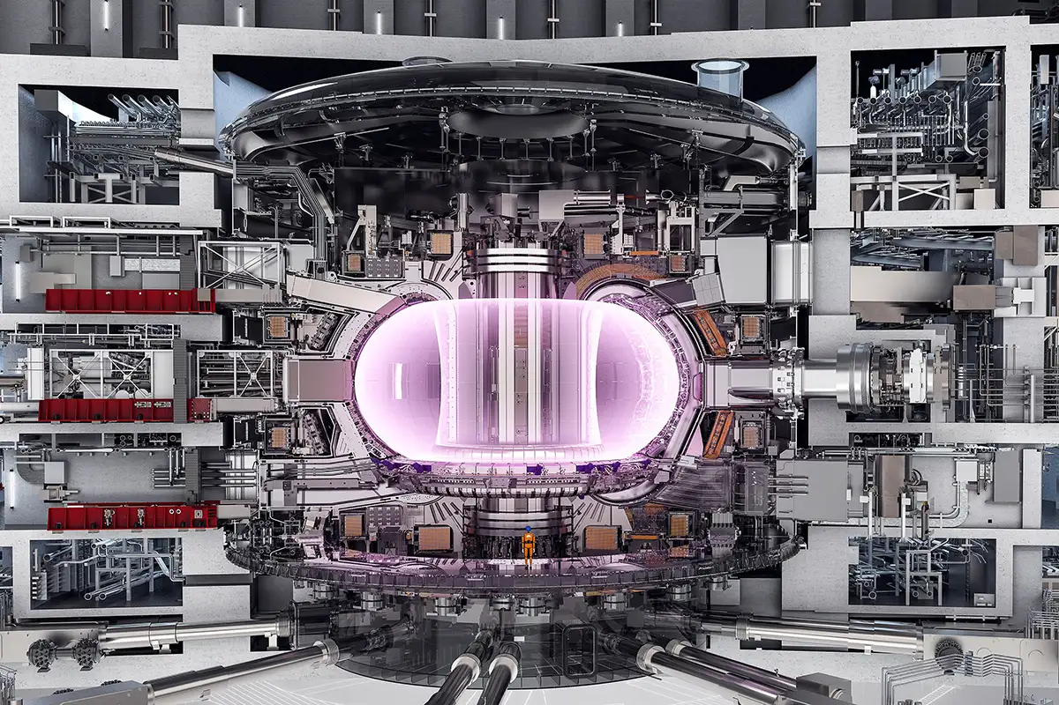
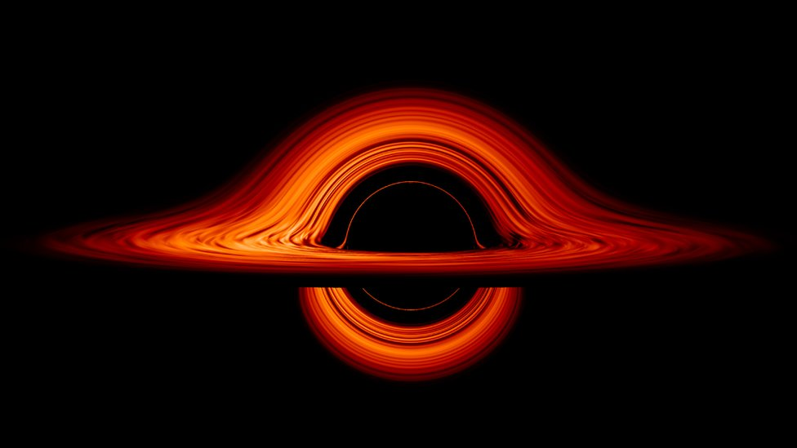
Experiments

Slide 24
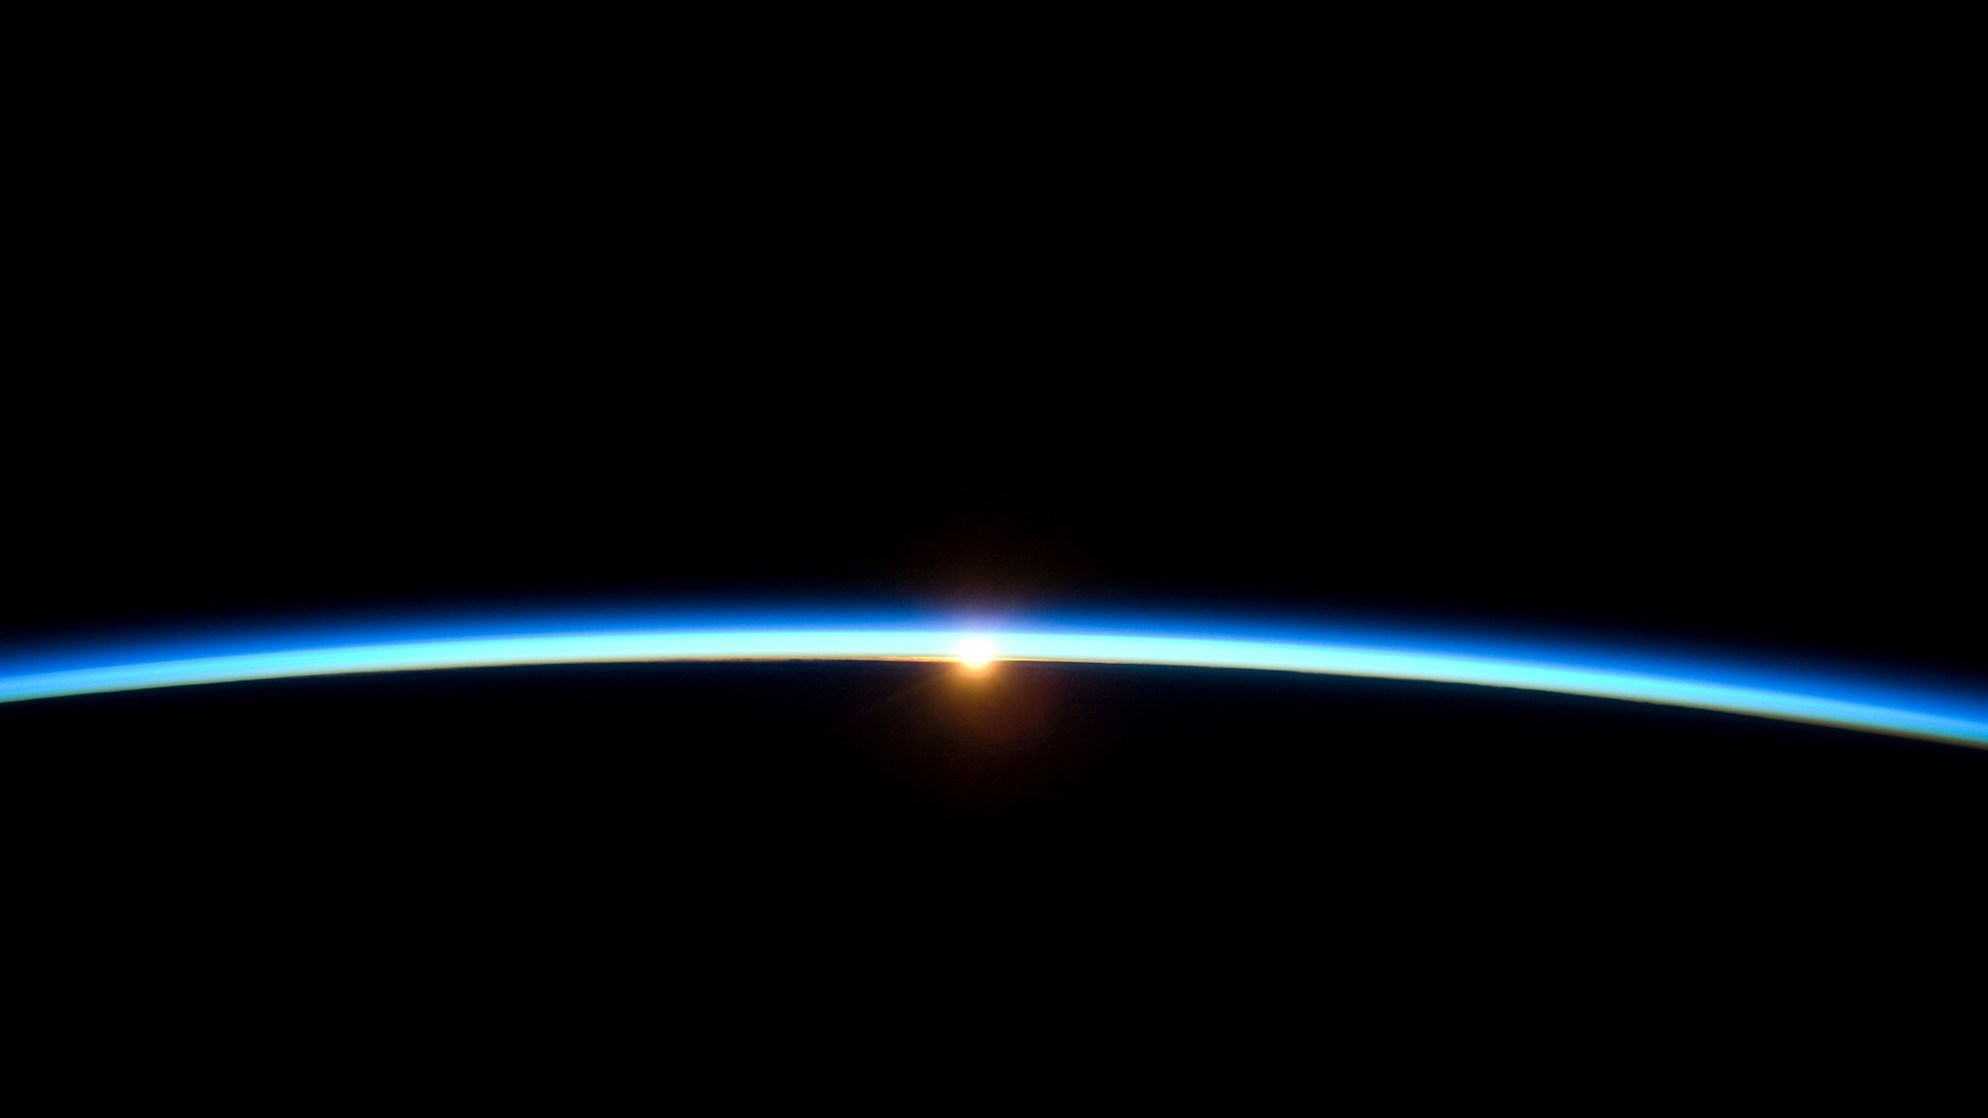
Questions?

